Slide 1

Spatial and storm-time dependence of electron microburst pitch angle isotropy
Presented by:
Conrad Meyer-Reed
Co-authors:
Lauren Blum, Mike Shumko

Slide 2
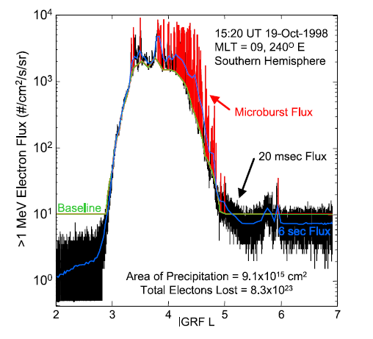
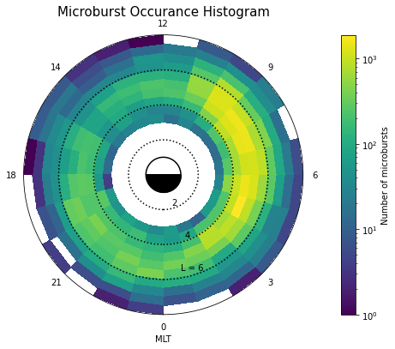
Abstract
This study uses electron count data from the SAMPEX satellite to calculate a qualitative measurement of electron pitch angle isotropy associated with microbursts
(From O’Brien et al, 2004)
By correlating microburst isotropy with magnitude, L-Shell, MLT, Dst, and AE, we can better understand the spatial and storm-time dependence of electron loss mechanisms in the Earth’s radiation belts

Slide 3
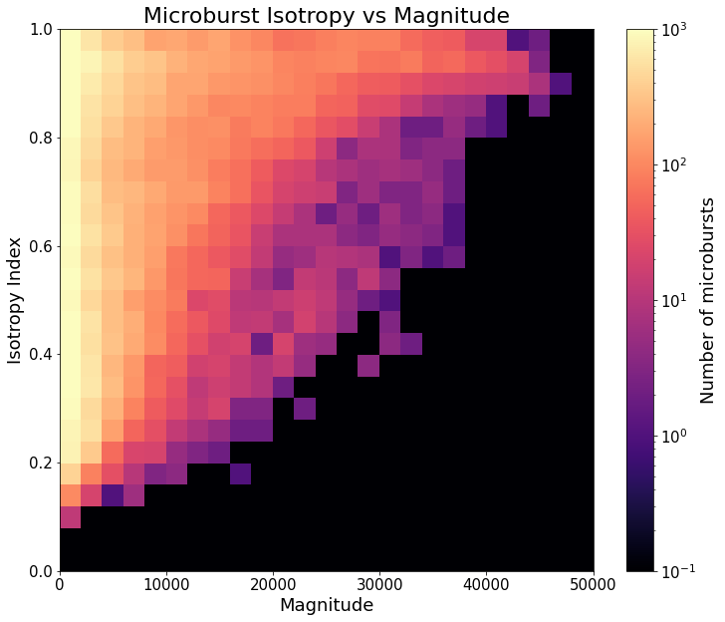
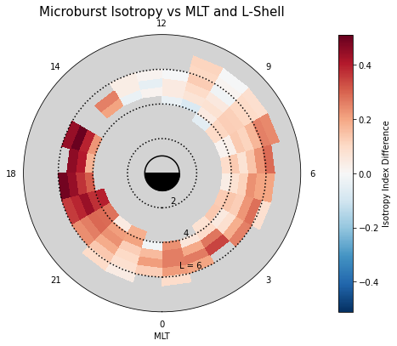
Key Findings
Recap: High isotropy corresponds to more electron precipitation; low isotropy corresponds to less electron precipitation
Low magnitude microbursts are widely varying in isotropy; high magnitude microbursts are more isotropic (top right figure)
Median Microburst Isotropy vs MLT and L-Shell
Microburst isotropy compared to background is highest in the evening magnetic local time region and lowest in the noon region (bottom left figure)
Microburst isotropy compared to background is highest during the initial phase and lowest during the recovery phase of intense geomagnetic storms (figure not shown)

Slide 4
Thank you!
Contact information:
Email: Conrad.Meyer-reed@colorado.edu
Cell: (574) 538-8023

